Slide 1


NLP PROJECT
Question Answering and CLASSIFICATION SYSTEM
DATA SET: IOS VS. ANDROID
By: Sarah Hussien
&
Hams Dorgham

Slide 2

Table of
CONTENTS
01
Introduction
02
Milestone 2
03
Milestone 3

Slide 3

INTRODUCTION
NLP question answering and classification systems play a crucial role in enhancing how machines interpret and respond to human language.
By enhancing the precision and speed of these systems, we can streamline information retrieval, enhance user experiences, and facilitate better human-machine communication.
Understanding the workings of question classification and answering in NLP is essential for developers to create reliable models and improve system performance through informed decisions on model architectures and training methodologies.

Slide 4
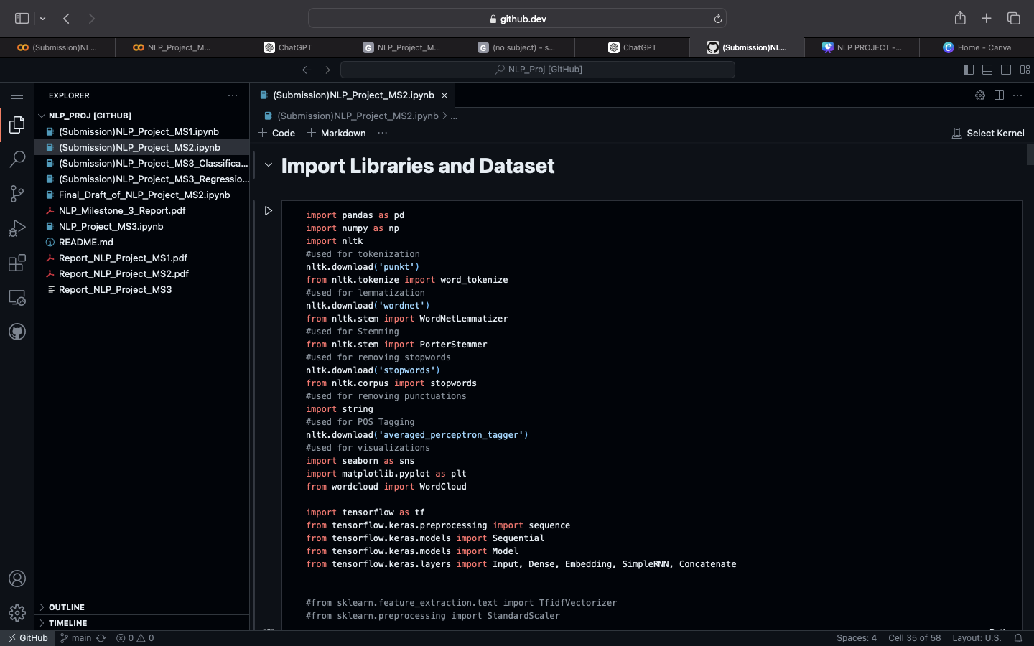

MILESTONE 2
IMPLEMENTS OF A TEXT CLASSIFICATION MODEL USING LSTM (LONG SHORT-TERM MEMORY) NEURAL NETWORK ARCHITECTURE ON A DATASET.
DATA PREPROCESSING:
The code begins by importing necessary libraries such as Pandas, NumPy, NLTK fOR NLP TASKS LIKE TOKENIZATION, LEMMATIZATION, ETC., AND TENSORFLOW/KERAS FOR BUILDING AND TRAINING THE NEURAL NETWORK.
TEXT PREPROCESSING STEPS LIKE CONVERTING TEXT TO LOWERCASE, REMOVING PUNCTUATION, TOKENIZATION, REMOVING STOPWORDS, AND LEMMATIZATION ARE PERFORMED USING NLTK.
THE PREPROCESSED TEXT IS THEN USED TO TRAIN A WORD2VEC MODEL TO CONVERT WORDS INTO DENSE VECTORS.

Slide 5
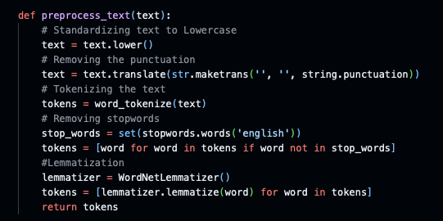
MILESTONE 2

Slide 6
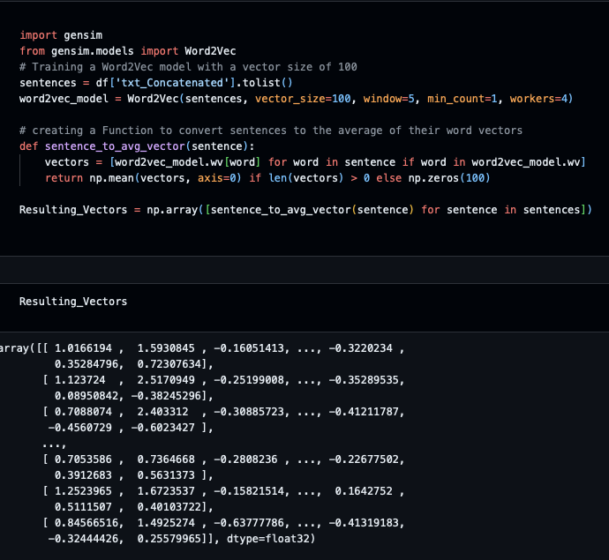
MILESTONE 2
2. Word Embedding with WORD2VEC:
THE WORD2VEC MODEL IS TRAINED ON THE PREPROCESSED TEXT DATA TO CREATE WORD EMBEDDINGS.
EACH WORD IS REPRESENTED AS A DENSE VECTOR OF A FIXED SIZE (100 DIMENSIONS).
THESE WORD EMBEDDINGS CAPTURE SEMANTIC MEANING AND CONTEXT OF WORDS IN THE TEXT.
3. FEATURE ENGINEERING:
Each sentence in the dataset is cONVERTED INTO AN AVERAGE VECTOR REPRESENTATION BY TAKING THE MEAN OF THE WORD VECTORS OF ALL WORDS IN THE SENTENCE.

Slide 7
MILESTONE 2
4. Splitting Data
5. Model Architecture:
A sequential LSTM-based neural network model is built using TensorFlow/Keras.
The input shape is defined based on the shape of the feature vectors obtained after feature engineering.
The LSTM layer with 64 units is followed by dropOUT REGULARIZATION TO PREVENT OVERFITTING.
DENSE LAYERS WITH RELU ACTIVATION ARE ADDED FOR FURTHER PROCESSING, AND A FINAL DENSE LAYER WITH SIGMOID ACTIVATION IS ADDED FOR BINARY CLASSIFICATION.
THE MODEL IS COMPILED WITH THE ADAM OPTIMIZER AND BINARY CROSS-ENTROPY LOSS FUNCTION.
6. MODEL TRAINING:
THE MODEL IS TRAINED ON THE TRAINING DATA FOR 10 EPOCHS WITH A BATCH SIZE OF 32.
VALIDATION DATA IS ALSO SPECIFIED FOR MONITORING THE MODEL'S PERFORMANCE DURING TRAINING.

Slide 8
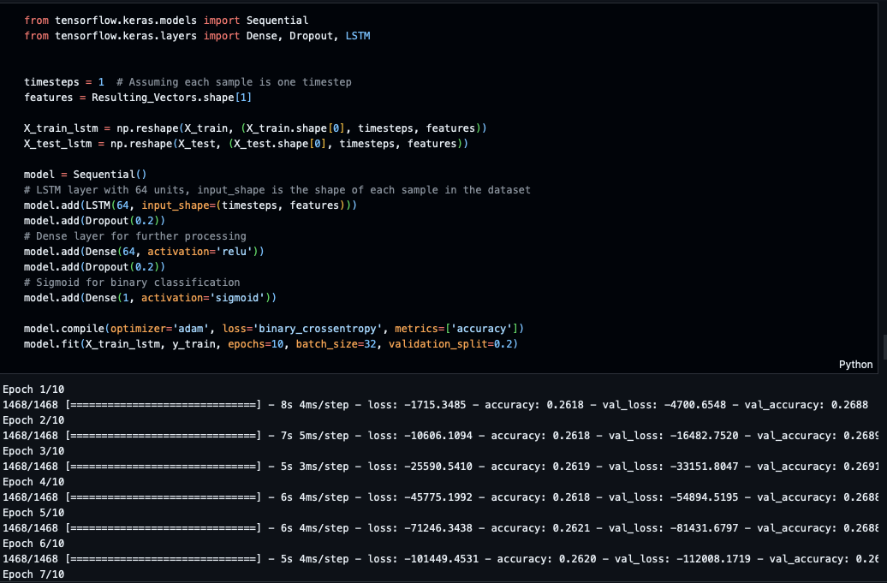

Slide 9
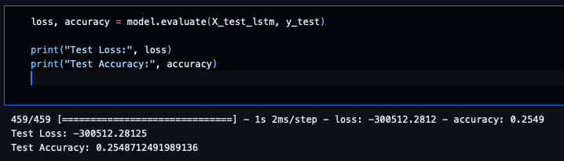
7. MODEL EVALUATION
-TEST LOSS OF -300512.28125 IS EXTREMELY NEGATIVE. LOSS VALUES ARE TYPICALLY NON-NEGATIVE, REPRESENTING THE DISCREPANCY BETWEEN PREDICTED AND TRUE VALUES.
-SUCH A LARGE NEGATIVE LOSS VALUE IS HIGHLY UNUSUAL AND INDICATES A SIGNIFICANT PROBLEM WITH THE MODEL OR ITS EVALUATION. IT COULD BE AN INDICATION OF INCORRECT LOSS CALCULATION OR A MALFUNCTION IN THE MODEL'S TRAINING OR EVALUATION PROCESS.
- TEST ACCURACY OF APPROXIMATELY 25.49% IS RELATIVELY LOW.
-WHILE TEST ACCURACY VALUES VARY BASED ON THE SPECIFIC TASK AND DATASET, A TEST ACCURACY OF AROUND 25% SUGGESTS THAT THE MODEL'S PERFORMANCE IS NOT SATISFACTORY. IT MEANS THAT THE MODEL IS CORRECTLY CLASSIFYING ONLY ABOUT A QUARTER OF THE INSTANCES IN THE TEST SET.

Slide 10
MILESTONE 2
LIMITATIONS AND CONSIDERATIONS:
A RELATIVELY SIMPLE LSTM ARCHITECTURE WAS USED, WHICH MIGHT NOT CAPTURE COMPLEX PATTERNS IN TEXT DATA EFFECTIVELY, ESPECIALLY FOR LARGE DATASETS WITH DIVERSE TEXT STRUCTURES.
WORD2VEC EMBEDDINGS MIGHT NOT CAPTURE RARE OR OUT-OF-VOCABULARY WORDS WELL, IMPACTING THE MODEL'S PERFORMANCE.
THE PREPROCESSING STEPS SUCH AS STOPWORD REMOVAL, LEMMATIZATION, ETC., MIGHT NOT BE OPTIMAL FOR ALL DATASETS AND COULD BE FURTHER REFINED BASED ON SPECIFIC REQUIREMENTS.
THE CODE DOES NOT INCLUDE EXTENSIVE HYPERPARAMETER TUNING, WHICH COULD POTENTIALLY IMPROVE THE MODEL'S PERFORMANCE.

Slide 11
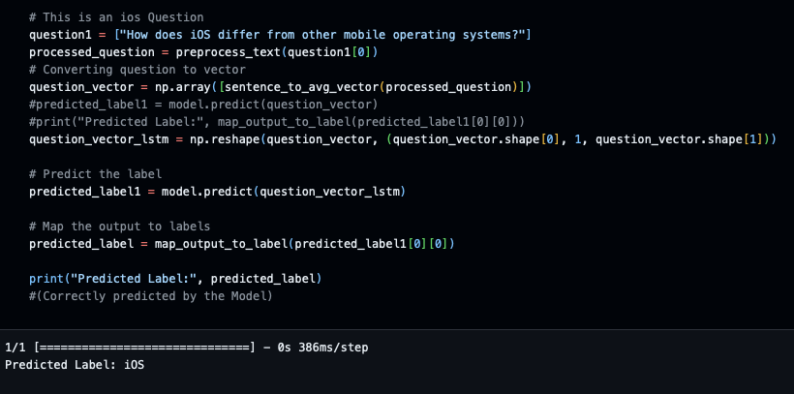
MILESTONE 2
EXAMPLE OF A USER INPUT AND MODEL’S PREDICTION

Slide 12
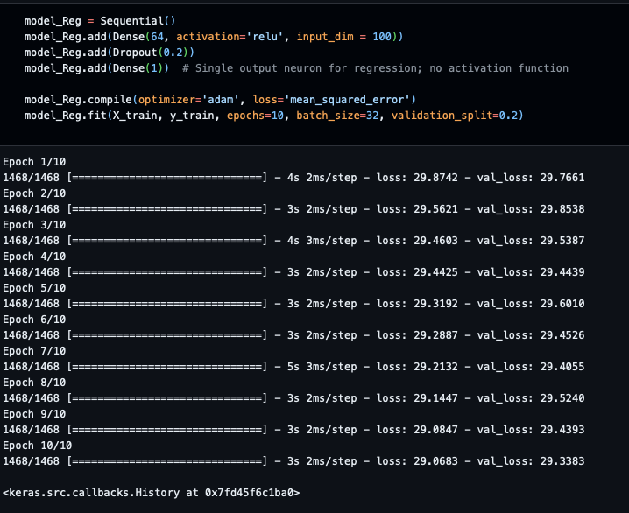
MILESTONE 2-REGRESSION MODEL

Slide 13
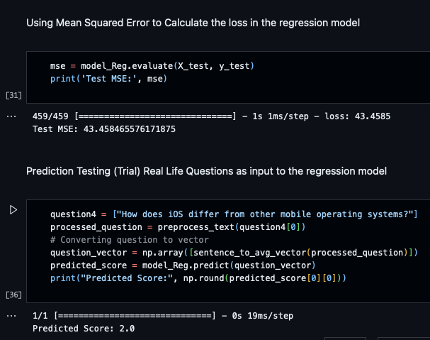
MILESTONE 2-REGRESSION MODEL

Slide 14
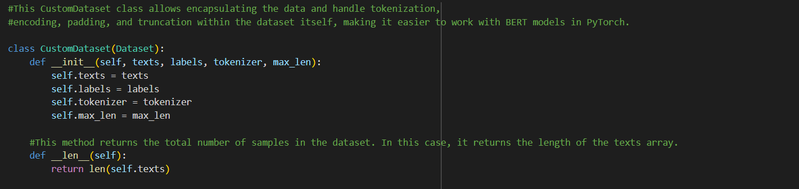
Milestone 3
Using predefined BERT model on Binary Classification task
Data Preparation
CustomDataset class is a tailored class used to prepare data for training machine learning models, particularly those based on transformers like BERT by handling tokenization, encoding, padding, and truncation of the text data

Slide 15
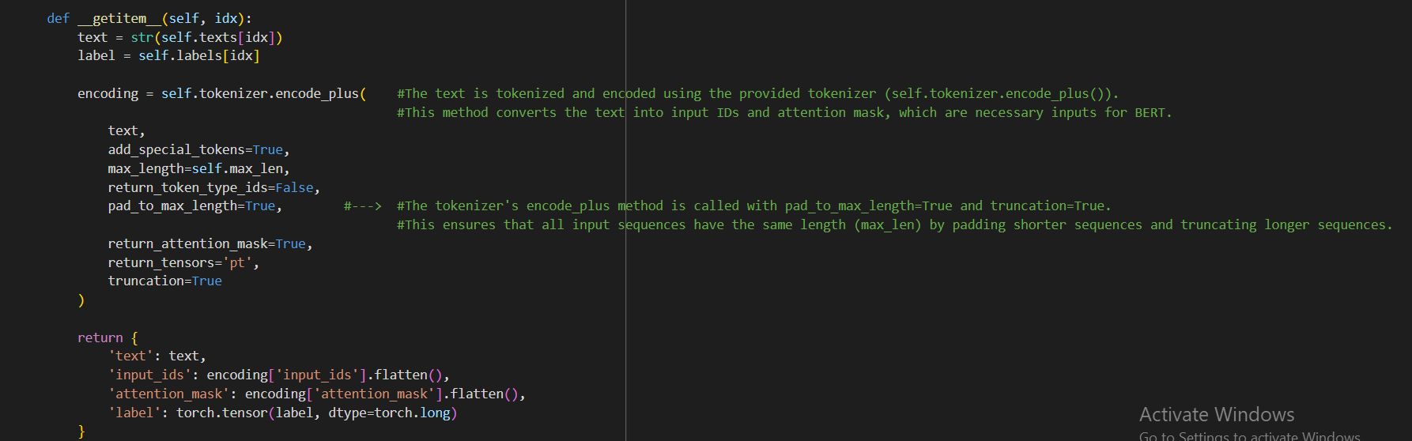
Milestone 3
“CustomDataset” class includes “getitem” method that performs the following:
allows indexing to access individual samples from the dataset.
tokenizes and encodes the input text using BertTokenizer
uses ”encodeplus” method to converts the input text into input IDs and attention mask
returns a dictionary containing the original text, input IDs, attention mask, and label to be used as inputs for transformer-based models like BERT.

Slide 16
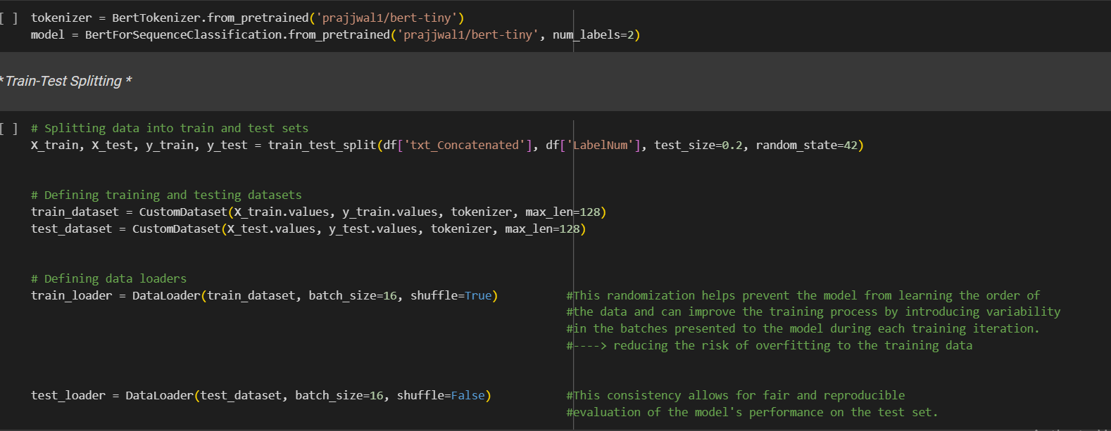
Milestone 3
2. Model Loading
The library used: BertForSequenceClassification.
The model name: ’prajjwal1/bert-tiny’ model

Slide 17
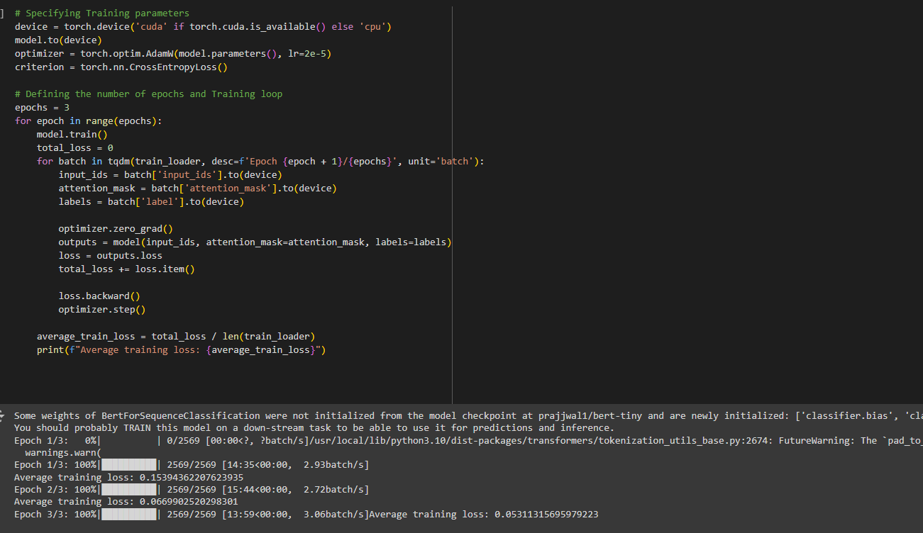
Milestone 3
3. Training the Model
1. Decided on number of epochs (3 in this case).
2. Within each epoch, the model undergoes training iterations over batches of data retrieved from the training loader.
3. During each iteration, the model’s predictions are compared with the ground truth labels, and a loss value is computed using the specified loss function (CrossEntropyLoss).
4. Backpropagation is then applied to compute the gradients of the loss with respect to the model’s parameters, followed by an optimization step to update the model’s weights.

Slide 18
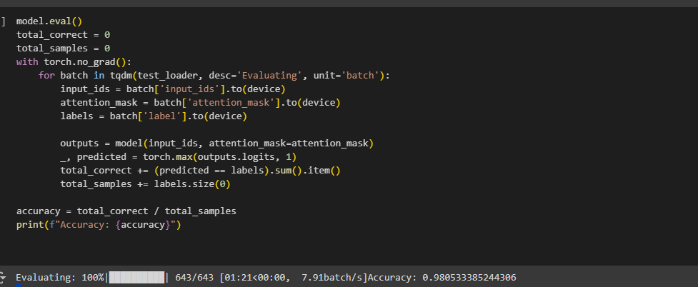
Milestone 3
4. Evaluating the Model
Our model achieved an accuracy of 0.98, meaning it correctly classified 98% of the inputs.
This high level of accuracy indicates robust performance in distinguishing between the two classes.

Slide 19
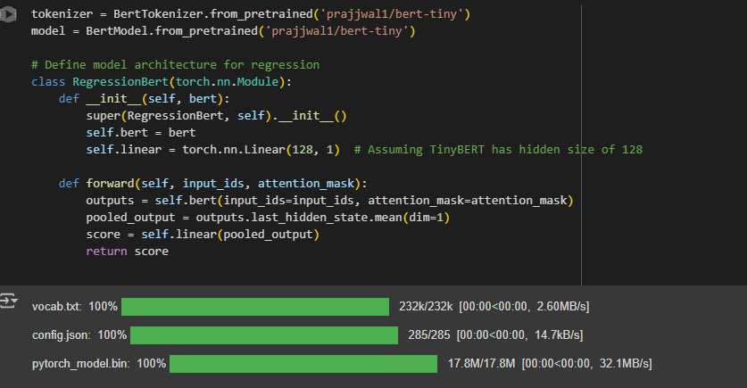
Milestone 3
Using predefined BERT model on Regression task
Data Preparation
Model Loading
The model architecture used:
RegressionBert
The model name:
’prajjwal1/bert-tiny’ model

Slide 20
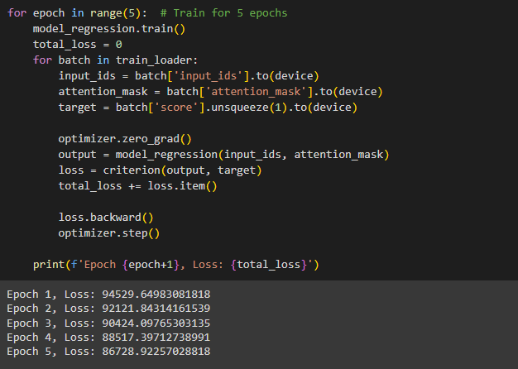
Milestone 3
3. Training the Model
1. A training loop for a regression task over five epochs is executed.
2. The training data is iterated over in batches using the trainloader, which contains preprocessed input sequences (inputids) and their corresponding target scores.
3. The model’s optimizer gradients are reset, and the model is passed the input sequences to generate predictions.
4. These predictions are compared with the target scores using a specified loss function (MSE), and the loss is calculated.
5. The gradients of the loss with respect to the model’s parameters are computed via backpropagation, and the optimizer (AdamW) adjusts the model’s parameters to minimize the loss.

Slide 21
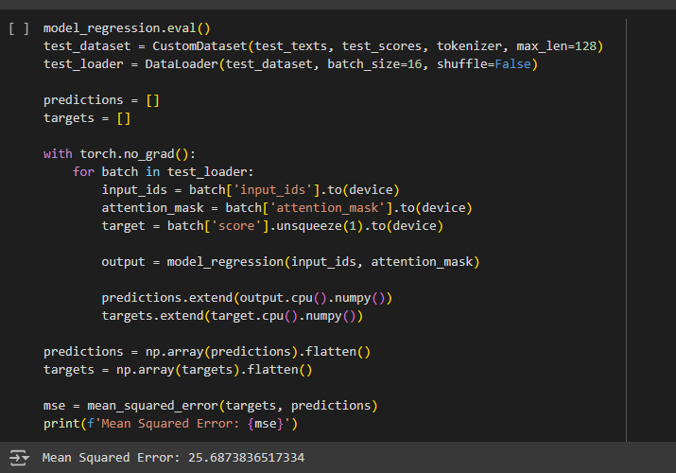
Milestone 3
4. Evaluating the Model
Our model has a MSE of 25.6 which means the average squared difference between the predicted and actual scores is 25.6.

Slide 22
Conclusion
In the Binary Classification Task:
Our predefined BERT model achieved an accuracy of 0.98 in classifying questions as related to Android or iOS.
The LSTM model achieved an accuracy of 0.25 which did not match the performance of BERT.
The pretrained BERT model used in Milestone 3 outperforms LSTM model used in Milestone 2 as it considers the entire context of a sentence, both from the left and the right, which enables it to understand the full meaning of each word in context while LSTM model captures dependencies by processing the input sequentially (one word at a time)

Slide 23
Conclusion
In the Regression Task:
Our predefined BERT model achieved a MSE of 25.68 in predicting the scores of the questions
The LSTM model achieved a MSE of 43.45
This significant difference in performance is due the architectural advantages of BERT over LSTM. BERT’s transformer architecture processes text bidirectionally, meaning it considers the full context of each word within a sentence from both directions, which allows it to capture intricate relationships and dependencies in the text more effectively while LSTMs process text sequentially and may struggle with capturing the full context as effectively as BERT.
This sequential processing can lead to less effective handling of long-range dependencies and contextual information, resulting in higher prediction errors and thus a higher MSE in classification tasks.

Slide 24

THANK YOU

